Slide 1
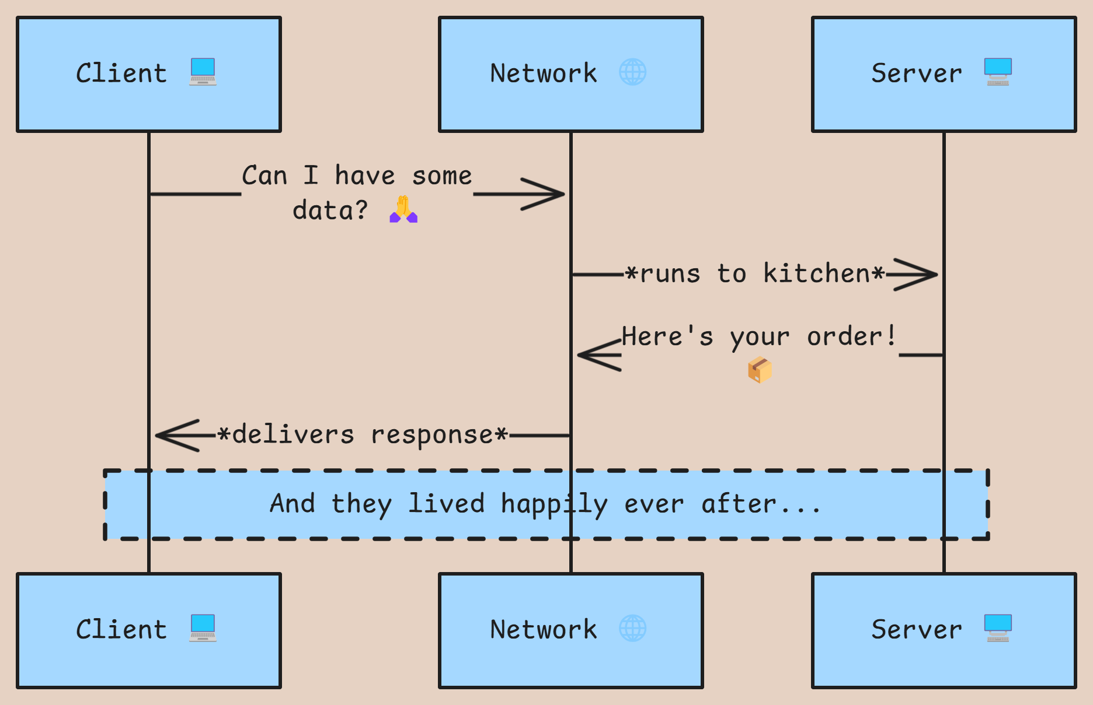
Client Server Model
"How I Met Your Data: A Tale of Two Computers"
The client-server model is like a restaurant:
The Client is the hungry customer (your device) who keeps asking "Where's my data?" 🍽️
The Server is the overworked chef (remote computer) who handles multiple orders 👨‍🍳
The Network is the waiter running back and forth with requests and responses 🏃‍♂️

Slide 2
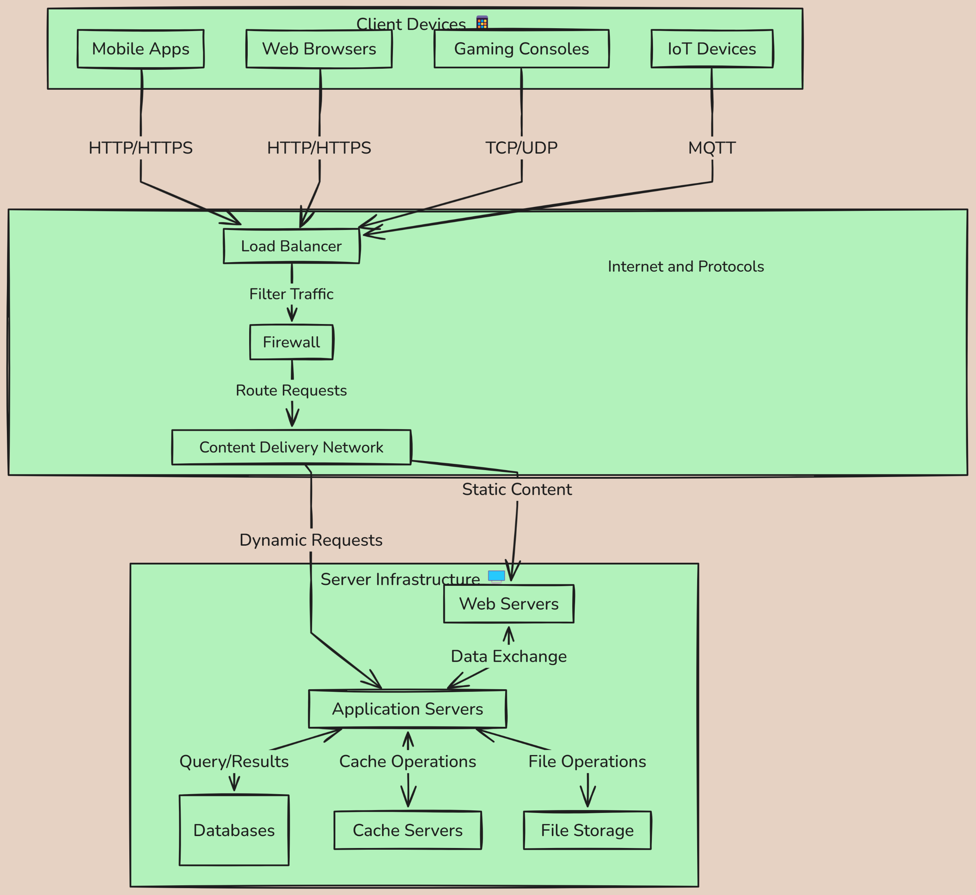
How You're Living the Client-Server Life
Common Examples:
Netflix and Chill 🎬
Your device (client): "Show me Stranger Things!"
Netflix server: "Here's your binge-worthy content!"
Social Media Drama 📱
Your app (client): "Any new likes on my post?"
Facebook server: "Still just your mom..."
Online Shopping Sprees 🛍️
Your browser (client): "Show me those shoes!"
Amazon server: "Here's everything you can't afford!"

Slide 3
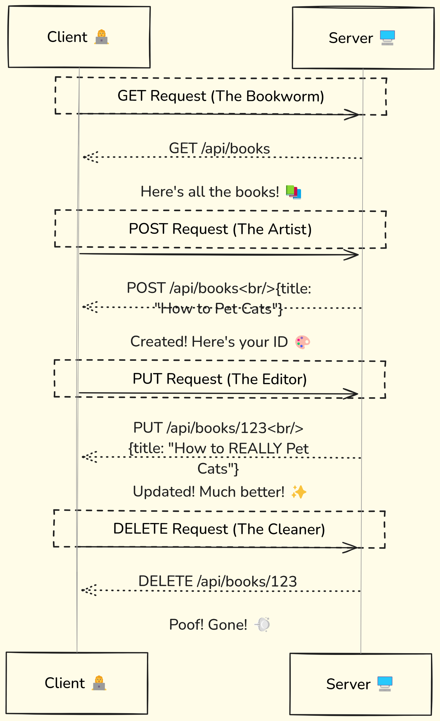
HTTP Requests - The Internet's Secret Language 🤫
The Four HTTP Methods (aka "The CRUD Boy Band" 🎤)
GET - The shy one who just wants to read stuff 📚
POST - The creative one always making new things ✨
PUT/PATCH - The perfectionist who updates everything ✏️
DELETE - The cleanup crew 🧹

Slide 4
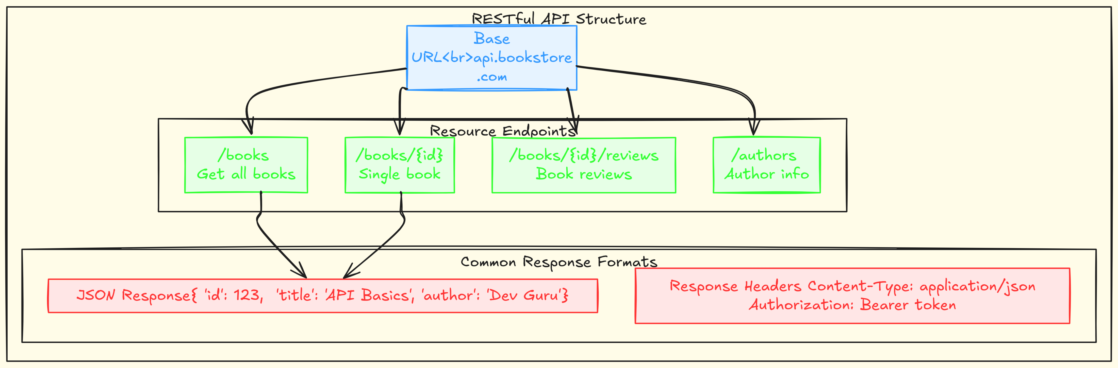
APIs & Endpoints - Your Gateway to Web Services 🌐
API Structure Basics
Base URL - The starting point of all requests
Example: https://api.bookstore.com
Like the street address of our digital service
Resource Endpoints - Specific paths to access different data
/books - Collection of all books
/books/{id} - Specific book by ID
/books/{id}/reviews - Reviews for a specific book
Query Parameters - Additional filters and options
/books?genre=fiction - Get only fiction books
/books?sort=price&order=desc - Sort by price, descending
/books?limit=10&page=2 - Pagination example

Slide 5
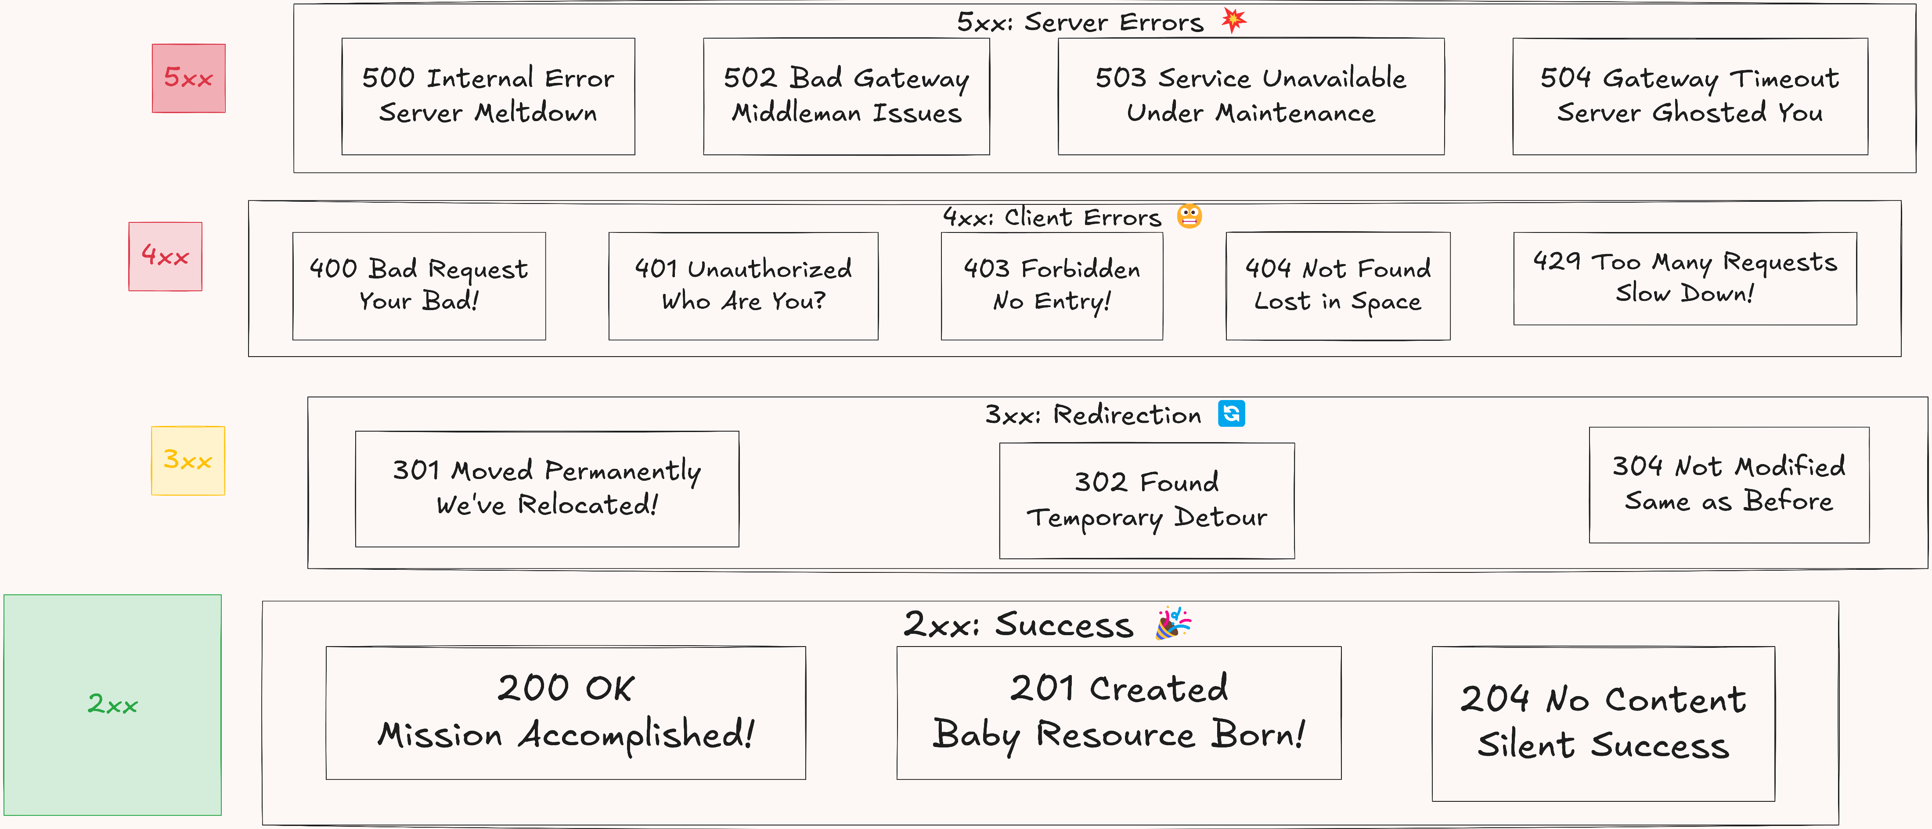
HTTP Status Codes - What's Your Server Trying to Tell You? 🤔

Slide 6
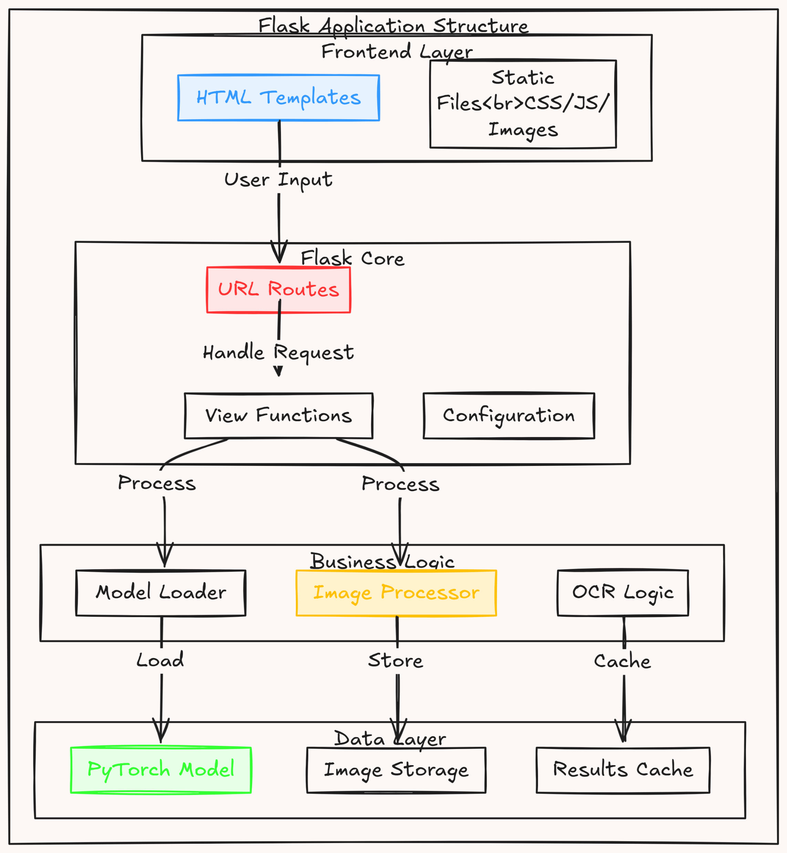
OCR Web Application with Flask 🔍

Slide 7
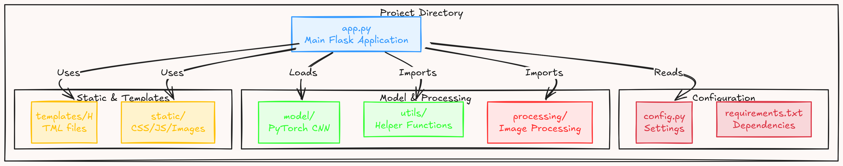
Implementation Roadmap 🚀
Core Features
Image upload & validation
PyTorch model integration
Text detection processing
Result display & caching

Slide 8
Connecting the Frontend and Backend: Where Magic Happens!
—a love story featuring APIs, data, and debug logs.

Slide 9
Frontend vs. Backend: The Epic Battle
Frontend (The Face):
What users see and interact with—HTML, CSS, JavaScript, React, Vue, etc.
Example: The shiny button users click to "Order Pizza."
Frontend makes things look clickable; Backend makes them actually work.

Slide 10
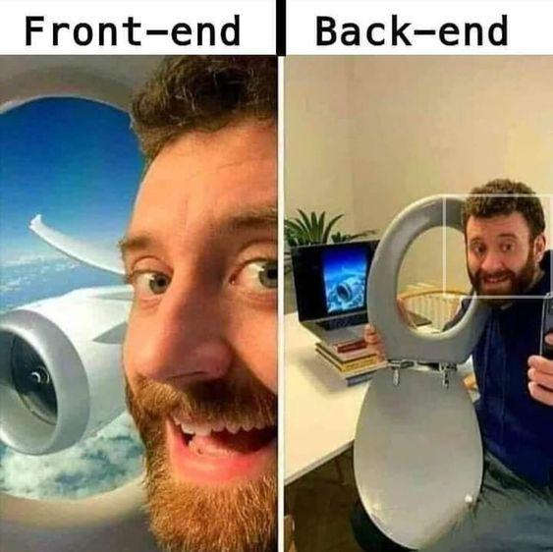

Slide 11
Frontend vs. Backend: The Epic Battle
Backend (The Brain):
Logic, data handling, APIs—Node.js, Python, Java, Databases (SQL/NoSQL).
Example: Verifying if the pizza place actually exists and can deliver to Antarctica.
Frontend asks, ‘What’s your name?’ Backend checks if you exist.

Slide 12
API: The Matchmaker
What’s an API?
API (Application Programming Interface) bridges the frontend and backend.
Think of it as a waiter taking your order (frontend) and delivering food from the kitchen (backend).

Slide 13
API: The Matchmaker
What’s an API?
API (Application Programming Interface) bridges the frontend and backend.
Think of it as a waiter taking your order (frontend) and delivering food from the kitchen (backend).

Slide 14
API: The Matchmaker
Example Workflow:
Frontend sends a Get Request : “Show me pizza options.”
Backend responds: “Here are all the pizzas. Gluten-free? Good luck.”
Frontend displays options, Backend processes the order.

Slide 15
Taking It Live: Enter the Cloud!
Why Cloud?
Scalability, reliability, and because hosting it on your laptop isn’t an option.
Example services: AWS, Google Cloud, Microsoft Azure.

Slide 16
Taking It Live: Enter the Cloud!
Why Cloud?
Scalability, reliability, and because hosting it on your laptop isn’t an option.
Example services: AWS, Google Cloud, Microsoft Azure.

